Slide 1


SS8H1b&c
European
Exploration
Settlement
and
© 2014 Brain Wrinkles

Slide 2
Standards
SS8H1 The student will evaluate the development of Native American cultures and the impact of European exploration and settlement on the Native American cultures in Georgia.
b. Evaluate the impact of European contact on Native American cultures; include Spanish missions along the barrier islands, and the explorations of Hernando De Soto.
c. Explain reasons for European exploration and settlement of North America, with emphasis on the interests of the French, Spanish, and British in the southeastern area.
© 2014 Brain Wrinkles

Slide 3
Teacher Directions – CLOZE Notes
The next pages are handouts for the students to use for note-taking during the presentation. (Print front to back to save paper and ink.)
Check the answers as a class after the presentation.
© 2014 Brain Wrinkles

Slide 4
European Contact
Spanish _____________________________________________ entered Georgia in the ______________________________ .
European missionaries attempted to _____________________________________________ to their religion.
They also ______________________________ that wiped out a large portion of the native population.
Hernando De Soto
In ______________________________ , a Spanish conquistador named ______________________________ led 600 soldiers across Georgia.
De Soto was searching for “______________________________ ”.
De Soto’s men _____________________________________________ the natives in order to gain information about gold and silver locations.
He ______________________________ , but he did leave a lasting impact on the Native Americans in Georgia.
Diseases
De Soto and other Spanish explorers _____________________________________________ that devastated the Native American population.
Some of the diseases included ______________________________ , influenza, ______________________________ , and chicken pox.
The natives had ______________________________ to the diseases.
______________________________ were wiped out at a time.
Missions
In 1565, the Spanish _____________________________________________ , Florida as their first permanent settlement.
Then they moved north to establish posts on some of _____________________________________________ including St. Catherine’s, Cumberland, ______________________________ , and Sapelo Islands.
They established ______________________________ ) in all of these places with the goal of converting Native Americans to the ______________________________ .
© 2014 Brain Wrinkles
Exploration CLOZE Notes 1

Slide 5
The 3 G’s
GOLD: Many of the explorations were for economic reasons. Explorers were __________________________________________________ .
GOD: Another reason for exploration was a desire to ______________________________ to other lands.
GLORY: Many explorers were driven by personal ambition for ______________________________ .
New World
Beginning in 1400, _____________________________________________ competed to conquer and claim ______________________________ .
In the 1490s, ______________________________ was given ships and sailors by the Spanish monarchy.
His goal was to find a quick ______________________________ through the Atlantic Ocean.
Columbus didn’t make it to Asia, but actually landed in the ______________________________ …
Spain
Exploration of the New World brought ______________________________ to Spain.
Spain had a ______________________________ that spanned the globe.
By the 1500s, the Spanish had established numerous settlements from ______________________________ .
Great Britain
Great Britain began exploring the New World in the ______________________________ .
British explorers hoped to _________________________________________ that they could use to manufacture goods in their own country.
Great Britain settled the ______________________________ (from Georgia to Maine) from 1607 to 1732.
France
French explorers traveled to the New World in the ___________________.
In 1603, French explorers found great _________________________________________ in eastern Canada and claimed the area for France.
This became the center for the ______________________________ in the New World.
The French also explored along the Mississippi River and established settlements like ______________________________________________ .
Native Americans
As the Europeans ______________________________ in the Americas, they had ______________________________________________________ living in the areas.
Many natives were _______________________________________ from diseases.
The Europeans were only interested in the natives for trading, ______________________________ , and military alliances.
© 2014 Brain Wrinkles
Exploration CLOZE Notes 2

Slide 6
European Contact
Spanish explorers and missionaries entered Georgia in the early 1500s.
European missionaries attempted to convert the natives to their religion.
They also brought diseases that wiped out a large portion of the native population.
Hernando De Soto
In 1540, a Spanish conquistador named Hernando De Soto led 600 soldiers across Georgia.
De Soto was searching for “cities of gold”.
De Soto’s men tortured and enslaved the natives in order to gain information about gold and silver locations.
He never found the gold, but he did leave a lasting impact on the Native Americans in Georgia.
Diseases
De Soto and other Spanish explorers brought horrible diseases that devastated the Native American population.
Some of the diseases included smallpox, influenza, measles, and chicken pox.
The natives had no resistance to the diseases.
Entire villages were wiped out at a time.
Missions
In 1565, the Spanish established St. Augustine, Florida as their first permanent settlement.
Then they moved north to establish posts on some of Georgia’s barrier islands, including St. Catherine’s, Cumberland, St. Simons, and Sapelo Islands.
They established missions (churches) in all of these places with the goal of converting Native Americans to the Catholic religion.
© 2014 Brain Wrinkles
Exploration CLOZE Notes 1

Slide 7
The 3 G’s
GOLD: Many of the explorations were for economic reasons. Explorers were seeking riches such as gold.
GOD: Another reason for exploration was a desire to spread religion to other lands.
GLORY: Many explorers were driven by personal ambition for glory and fame.
New World
Beginning in 1400, Spain, France, and Great Britain competed to conquer and claim land in North America.
In the 1490s, Christopher Columbus was given ships and sailors by the Spanish monarchy.
His goal was to find a quick route to Asia through the Atlantic Ocean.
Columbus didn’t make it to Asia, but actually landed in the Bahamas…
Spain
Exploration of the New World brought great wealth to Spain.
Spain had a huge empire that spanned the globe.
By the 1500s, the Spanish had established numerous settlements from Florida to Georgia.
Great Britain
Great Britain began exploring the New World in the late 15th century.
British explorers hoped to find raw materials that they could use to manufacture goods in their own country.
Great Britain settled the 13 colonies (from Georgia to Maine) from 1607 to 1732.
France
French explorers traveled to the New World in the 1600s.
In 1603, French explorers found great numbers of beaver in eastern Canada and claimed the area for France.
This became the center for the fur trade in the New World.
The French also explored along the Mississippi River and established settlements like New Orleans and Mobile.
Native Americans
As the Europeans competed for land in the Americas, they had little regard for Native Americans living in the areas.
Many natives were enslaved or killed from diseases.
The Europeans were only interested in the natives for trading, land deals, and military alliances.
© 2014 Brain Wrinkles
Exploration CLOZE Notes 2

Slide 8
SS8H1b&c
European
Exploration
Settlement
and
© 2014 Brain Wrinkles

Slide 9
SS8H1b
European
Contact
on Native Americans
© 2014 Brain Wrinkles

Slide 10
European Contact
Spanish explorers and missionaries entered Georgia in the early 1500s.
European contact made a dramatic impact on the Native Americans.
European missionaries attempted to convert the natives to their religion.
They also brought diseases that wiped out a large portion of the native population.
© 2014 Brain Wrinkles

Slide 11
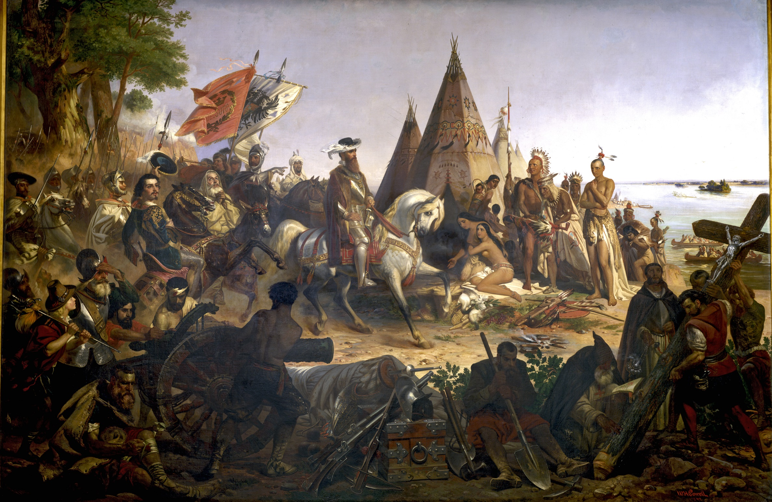
© 2014 Brain Wrinkles

Slide 12
Hernando De Soto
In 1540, a Spanish conquistador named Hernando De Soto led 600 soldiers across Georgia.
  De Soto was searching for “cities of gold”.
De Soto’s men tortured and enslaved the natives in order to gain information about gold and silver locations.
He never found the gold, but he did leave a lasting impact on the Native Americans in Georgia.
© 2014 Brain Wrinkles

Slide 13
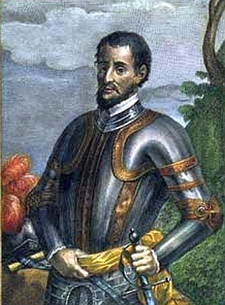
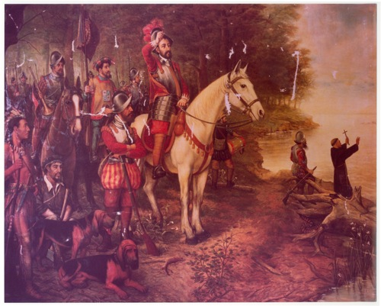
Hernando De Soto
© 2014 Brain Wrinkles

Slide 14
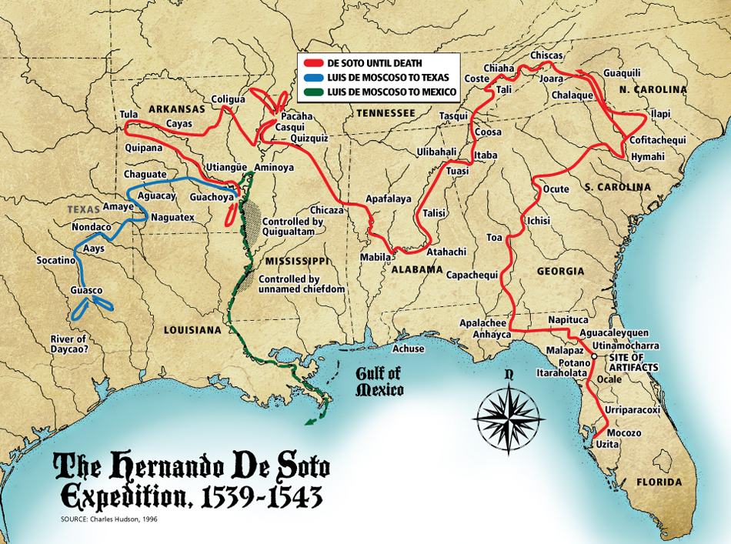
As Hernando De Soto marched throughout the Southeast, thousands of Native Americans were tortured and killed by his men.
© 2014 Brain Wrinkles

Slide 15
Diseases
De Soto and other Spanish explorers brought horrible diseases that devastated the Native American population.
Some of the diseases included smallpox, influenza, measles, and chicken pox.
The natives had no resistance to the diseases.
Entire villages were wiped out at a time.
© 2014 Brain Wrinkles

Slide 16
Missions
In 1565, the Spanish established St. Augustine, Florida as their first permanent settlement.
Then they moved north to establish posts on some of Georgia’s barrier islands, including St. Catherine’s, Cumberland, St. Simons, and Sapelo Islands.
They established missions (churches) in all of these places with the goal of converting Native Americans to the Catholic religion.
© 2014 Brain Wrinkles

Slide 17
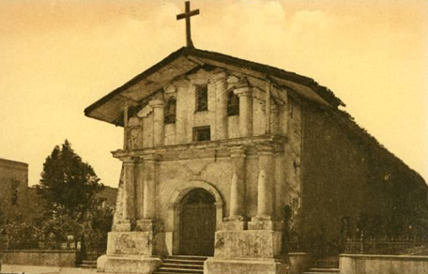
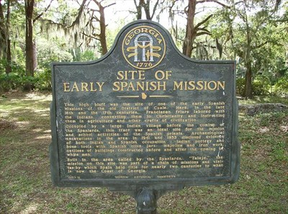
Spanish Missions were established along the barrier islands to convert natives to Christianity.
© 2014 Brain Wrinkles

Slide 18
SS8H1c
European
Exploration
© 2014 Brain Wrinkles

Slide 19
The 3 G’s…
Why did Europeans go exploring?
GOLD: Many of the explorations were for economic reasons. Explorers were seeking riches such as gold. (Spain)
GOD: Another reason for exploration was a desire to spread religion to other lands. (France)
GLORY: Many explorers were driven by personal ambition for glory and fame. (England)
© 2014 Brain Wrinkles

Slide 20
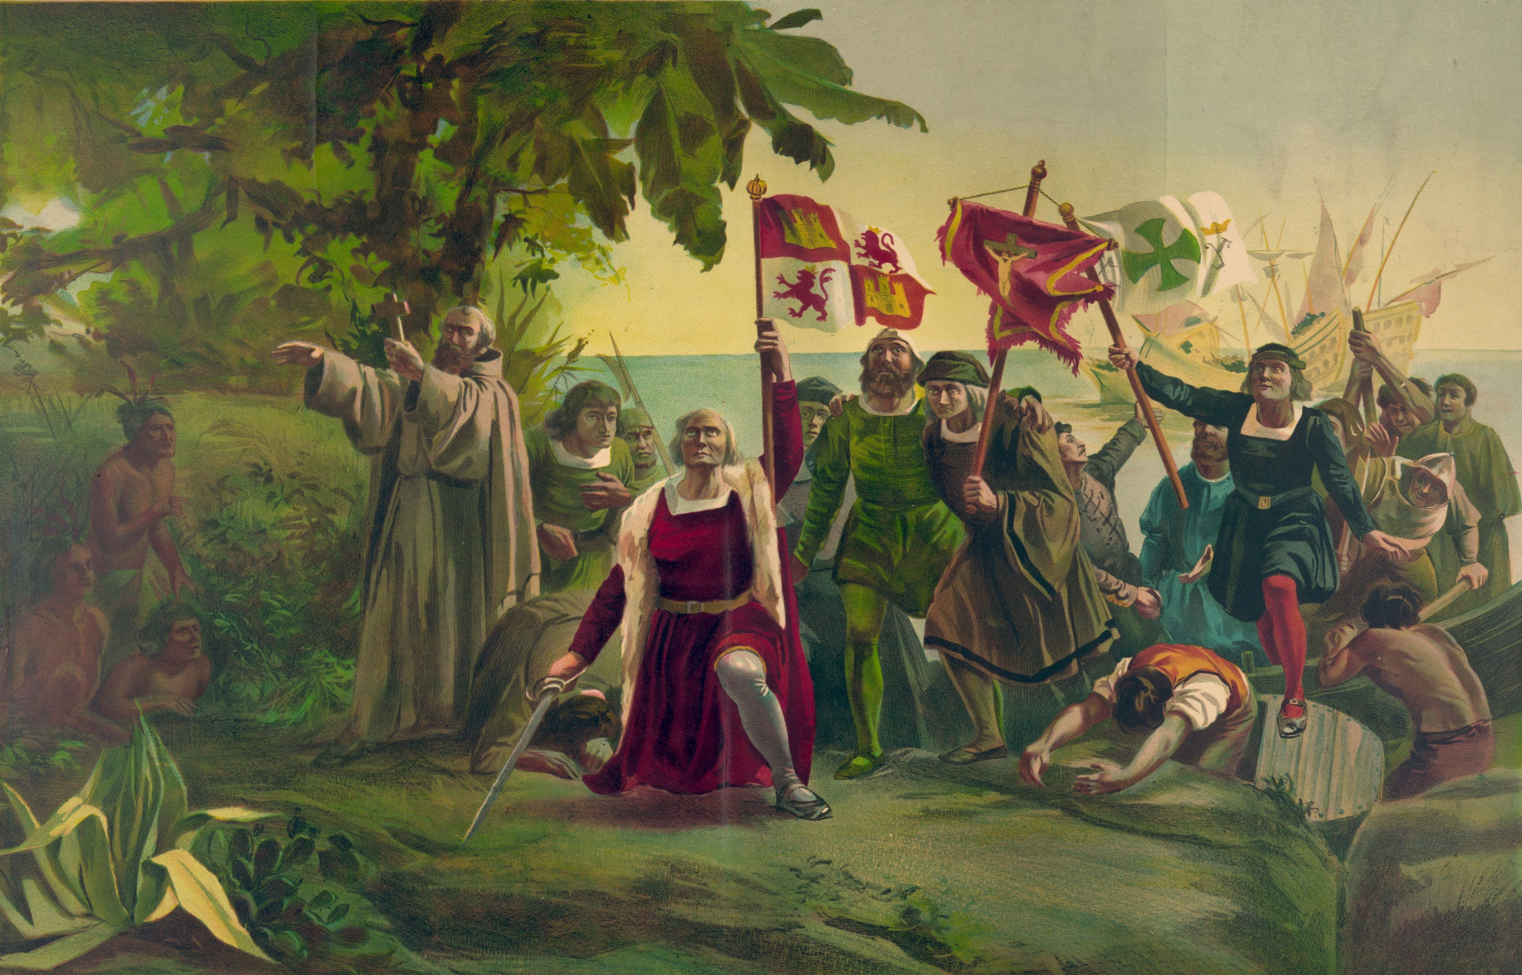
© 2014 Brain Wrinkles

Slide 21
New World
Beginning in 1400, Spain, France, and Great Britain competed to conquer and claim land in North America.
In the 1490s, Christopher Columbus was given ships and sailors by the Spanish monarchy.
  His goal was to find a quick route to Asia through the Atlantic Ocean.
Columbus didn’t make it to Asia, but actually landed in the Bahamas…
© 2014 Brain Wrinkles

Slide 22
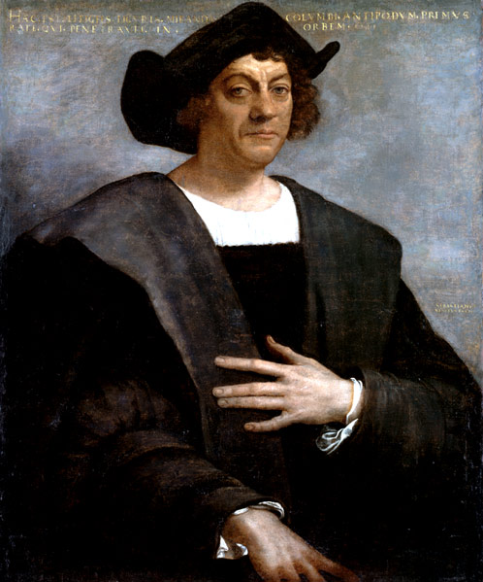
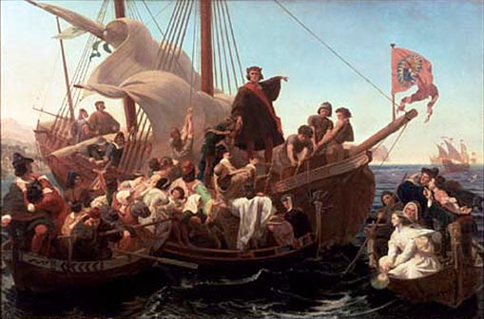
Christopher Columbus
© 2014 Brain Wrinkles

Slide 23
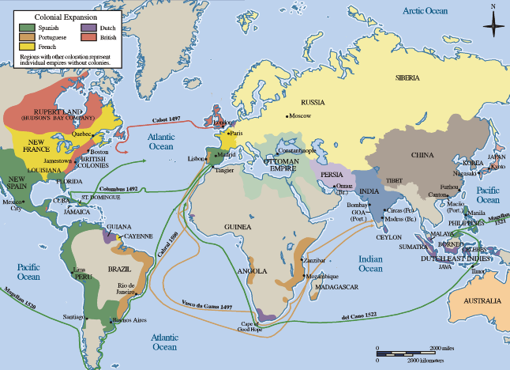
© 2014 Brain Wrinkles

Slide 24
Spain
Exploration of the New World brought great wealth to Spain.
Spain had a huge empire that spanned the globe.
By the 1500s, the Spanish had established numerous settlements from Florida to Georgia.
© 2014 Brain Wrinkles

Slide 25
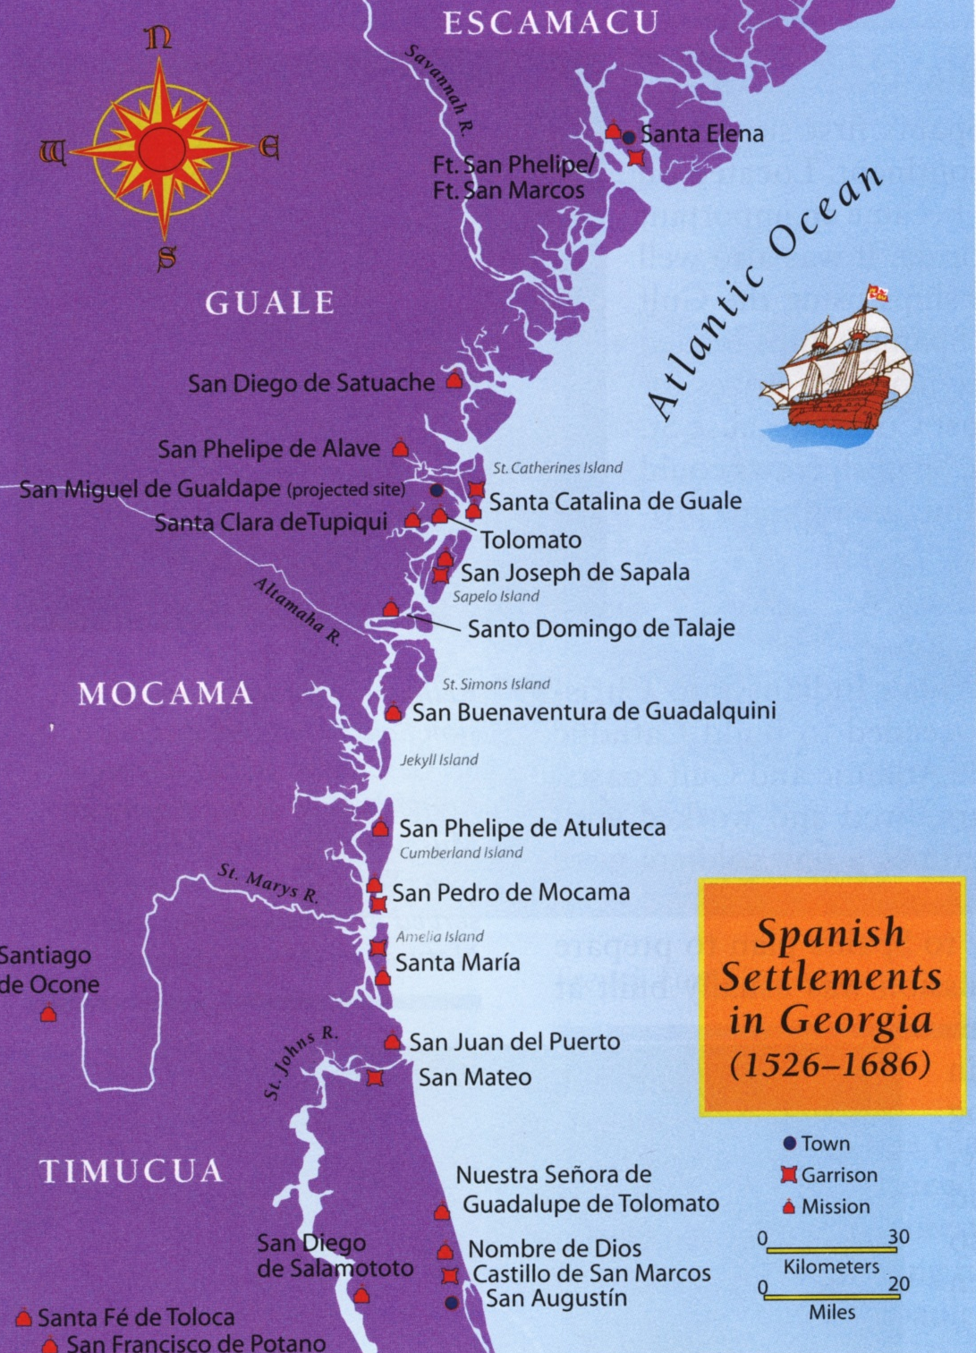
Spanish Missions and Forts Along Georgia & Florida’s Coast
© 2014 Brain Wrinkles

Slide 26
Great Britain
Great Britain began exploring the New World in the late 15th century.
British explorers hoped to find raw materials that they could use to manufacture goods in their own country.
Great Britain settled the 13 colonies (from Georgia to Maine) from 1607 to 1732.
© 2014 Brain Wrinkles

Slide 27
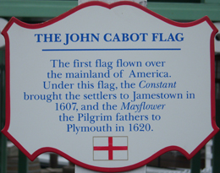
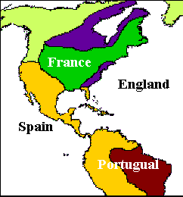
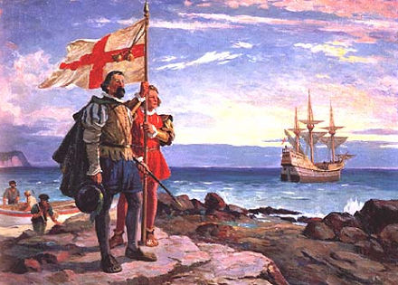
© 2014 Brain Wrinkles

Slide 28
France
French explorers traveled to the New World in the 1600s.
In 1603, French explorers found great numbers of beaver in eastern Canada and claimed the area for France.
  This became the center for the fur trade in the New World.
The French also explored along the Mississippi River and established settlements like New Orleans and Mobile.
© 2014 Brain Wrinkles

Slide 29
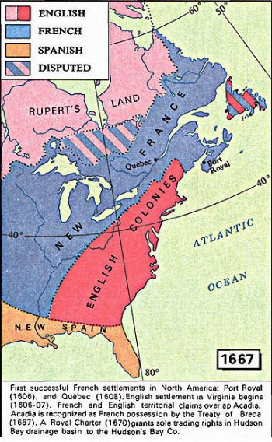
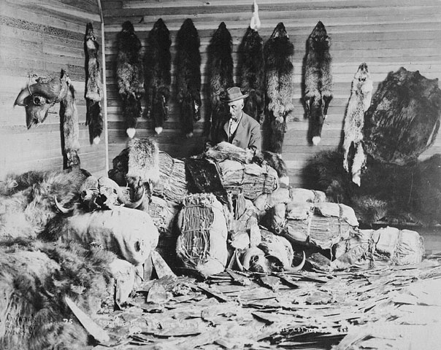
© 2014 Brain Wrinkles

Slide 30
Native Americans
As the Europeans competed for land in the Americas, they had little regard for Native Americans living in the areas.
Many natives were enslaved or killed from diseases.
The Europeans were only interested in the natives for trading, land deals, and military alliances.
© 2014 Brain Wrinkles

Slide 31
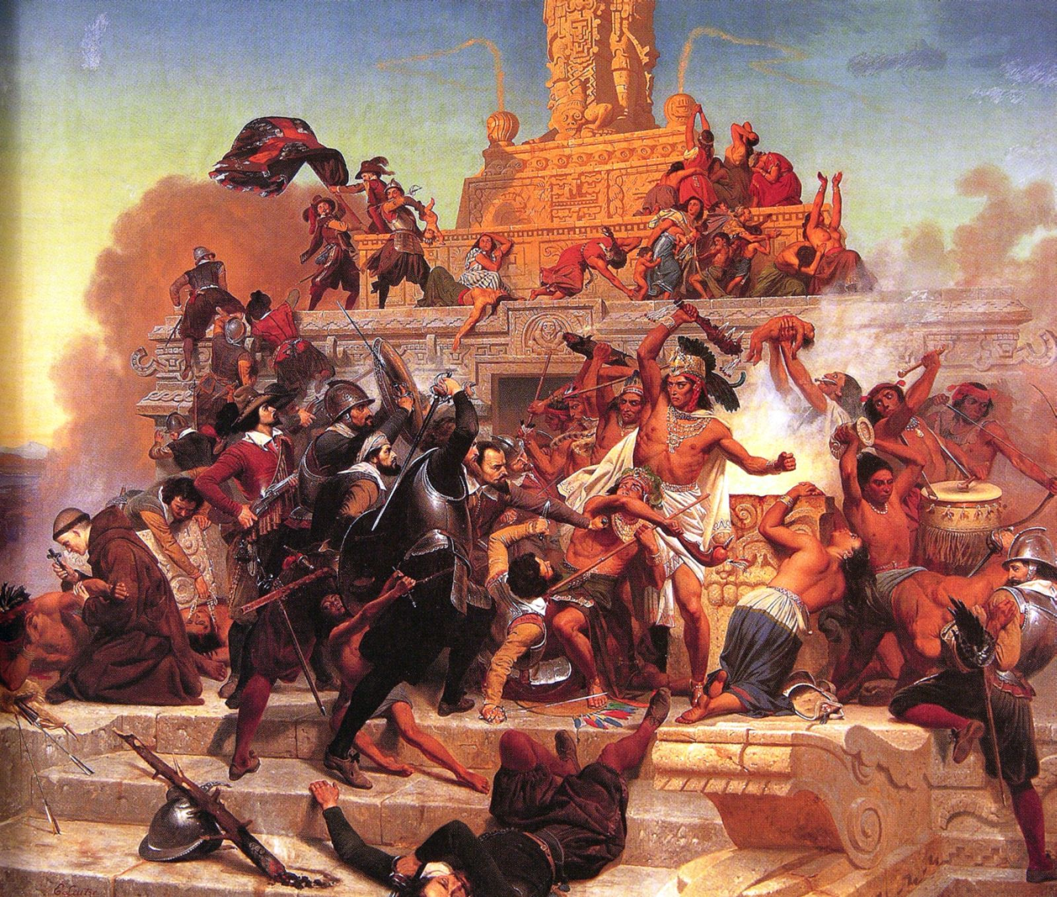
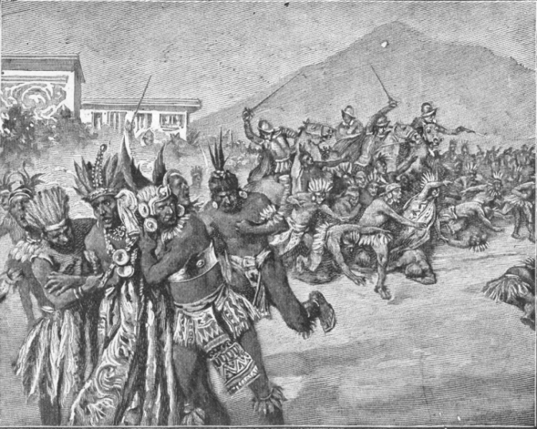
© 2014 Brain Wrinkles

Slide 32
Teacher Info – Citation for Injustice
Print off the Citation for Injustice handout for each student.
The students will write a “ticket” to Hernando de Soto (Offender) for his poor treatment of Native Americans. They should describe how the explorer treated Native Americans (took land, spread diseases, enslaved, killed, etc.). Then, they will write how they think de Soto should have treated the Indians.
In the “polaroid picture”, they will draw a scene that shows the poor treatment of Native Americans.
© 2014 Brain Wrinkles

Slide 33


Citation for Injustice
Ticket Number 67483928-22
Offender: Date:
Describe the Offense:
Instead, the lawbreaker should have:
Photographic Evidence
Signature:
© 2014 Brain Wrinkles

Slide 34
Teacher Info – Explorer Job Application
Print off the Job Application handout for each student.
The students will complete a job application as if they were interested in being an explorer during the 1500s. They should think about what an explorer did, the motivation behind exploring, etc., when completing the application.
In the picture box, the students will draw a picture of themselves as an explorer in action.
© 2014 Brain Wrinkles

Slide 35

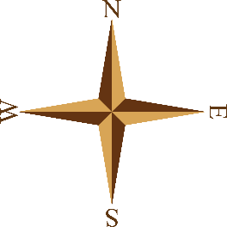
Explorer Job Application
Applicant:
Age:
Location:
Do you like taking risks? Describe the biggest adventure that you’ve been on.
Are you interested in making a lot of money? What would you do with a chest full of gold?
What is your religious preference? How do you feel about forcing others to convert to your religion?
Would you like to be famous? What would you do with fame and glory?
Your Skills in Action
© 2014 Brain Wrinkles

Slide 36
Teacher Directions – Extra! Extra!
The students will write a news article about the European countries’ impact on the Americas (exploration, contact with natives, settlement) as if they were alive during the time period.
They will write a catchy headline in the top box.
They will draw an illustration and a caption in the photograph section.
© 2014 Brain Wrinkles

Slide 37

Extra! Extra!
Directions: Write a news article that describes European countries impact on the Americas – from exploration to contact with natives, to settlement. Add a catchy headline (top box) and an action shot (snapshot box).
Date:
$
Article By:
© 2014 Brain Wrinkles

Slide 38
Teacher Directions – Ticket Out the Door
Have the students complete a Ticket Out the Door at the end of the lesson.
They will spend 3-5 minutes and write down all of the important things that they learned about European exploration, contact with Native Americans, and settlement in the New World.
© 2014 Brain Wrinkles

Slide 39


Pick Your Brain
Pick Your Brain
Write down the most important things that you can remember about European exploration, contact with Native Americans, and settlement in the New World.
Write down the most important things that you can remember about European exploration, contact with Native Americans, and settlement in the New World.
© 2014 Brain Wrinkles
© 2014 Brain Wrinkles

Slide 40




Thank You!
Thank you so much for downloading this file. I sincerely hope you find it helpful and that your students learn a lot from it! I look forward to reading your feedback in my store.
If you like this file, you might want to check out some of my other products that teach social studies topics in creative, engaging, and hands-on ways.
Best of luck to you this school year,
Ansley at Brain Wrinkles
© 2014 Brain Wrinkles

Slide 41





Terms of Use
© 2014 Brain Wrinkles. Your download includes a limited use license from Brain Wrinkles. The purchaser may use the resource for personal classroom use only. The license is not transferable to another person. Other teachers should purchase their own license through my store.
This resource is not to be used:
By an entire grade level, school, or district without purchasing the proper number of licenses. For school/district licenses at a discount, please contact me.
As part of a product listed for sale or for free by another individual.
On shared databases.
Online in any way other than on password-protected website for student use only.
© Copyright 2014. Brain Wrinkles. All rights reserved. Permission is granted to copy pages specifically designed for student or teacher use by the original purchaser or licensee. The reproduction of any other part of this product is strictly prohibited. Copying any part of this product and placing it on the Internet in any form (even a personal/classroom website) is strictly forbidden. Doing so makes it possible for an Internet search to make the document available on the Internet, free of charge, and is a violation of the Digital Millennium Copyright Act (DMCA).
Thank you,
Ansley at Brain Wrinkles
Clipart, fonts, & digital papers for this product were purchased from:
© 2014 Brain Wrinkles

